Slide 1
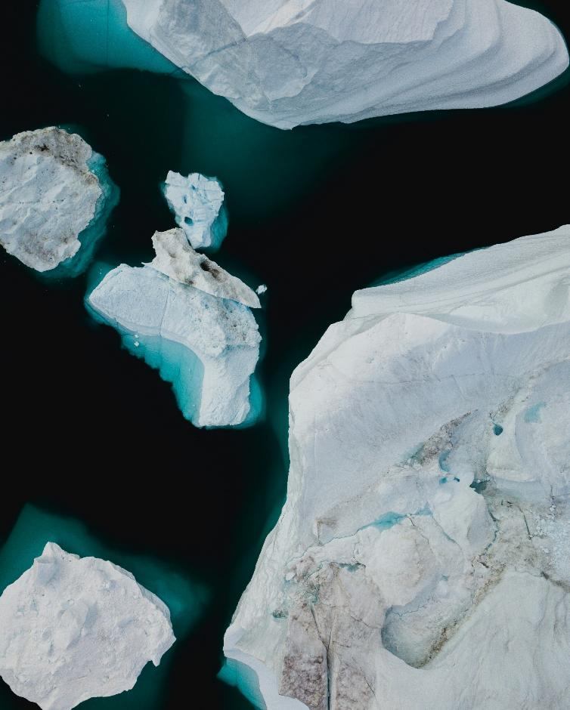
Title of the Presentation comes here
First Name Last Name
Organization
dd mm yyyy

Slide 2
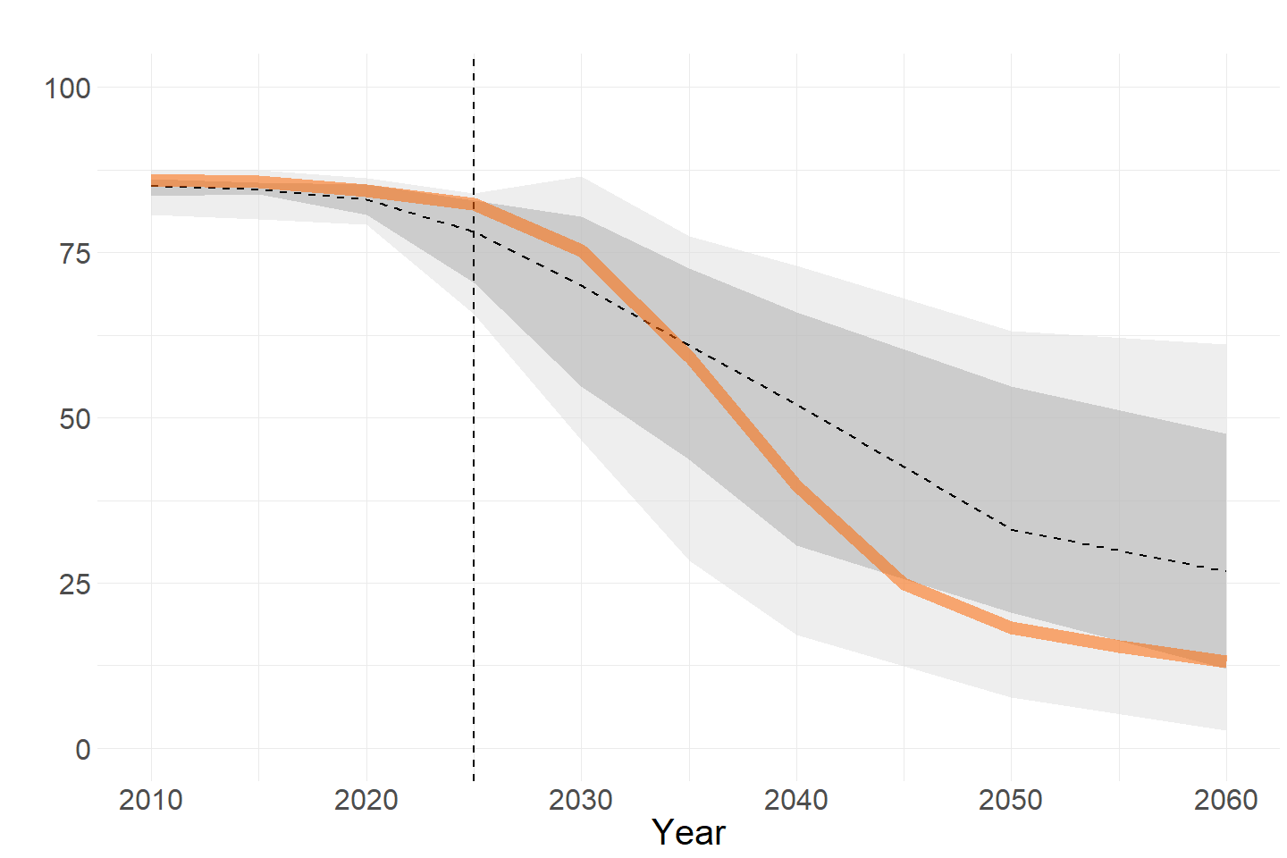
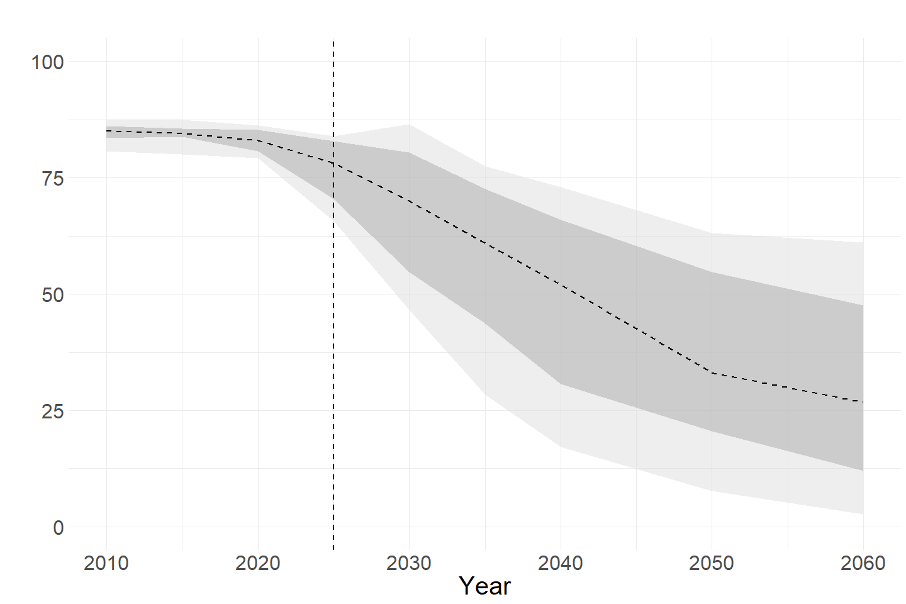
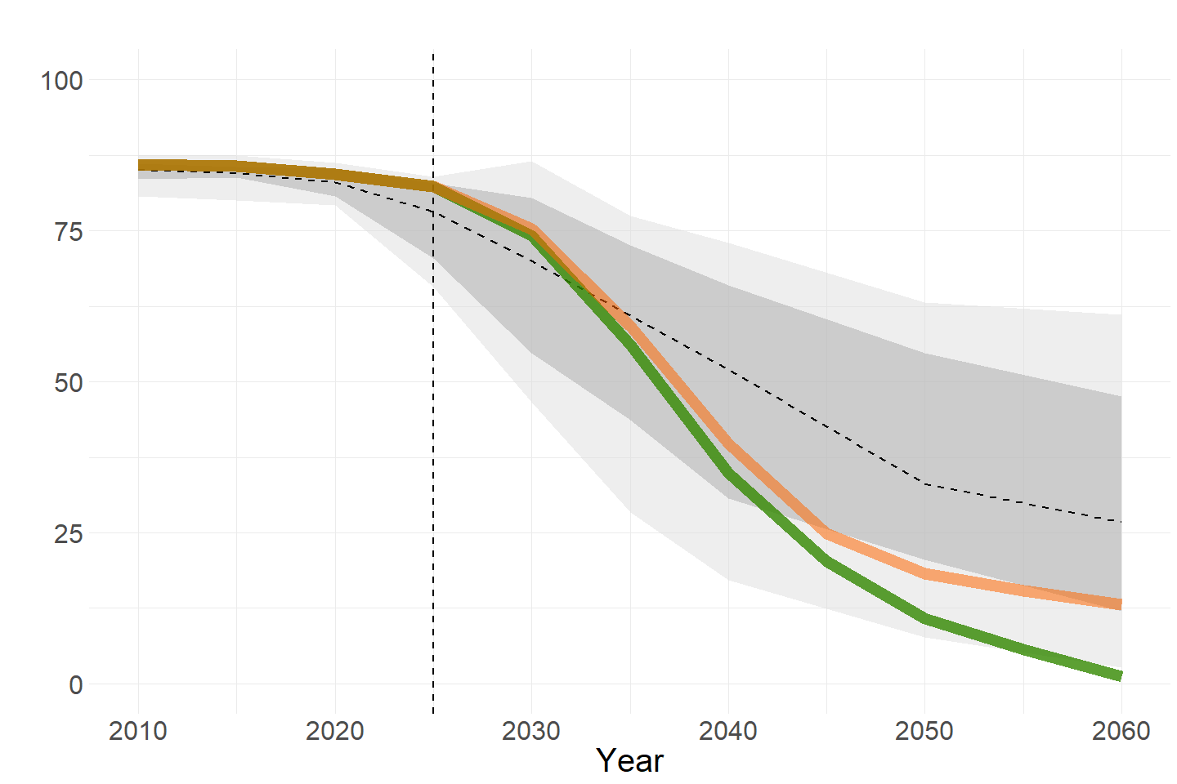
Fossil fuels in Paris-aligned pathways
% of primary energy
GST 28a
Tripling renewable capacity by 2030
5,266 GW (2025) > 10,600 GW - 10,800 GW (2030)
Scenarios
AR6 C1 & C2 - - Median ▮ Full range ▮ 5 – 95%
GST 28b
Phase down of unabated coal power
29% (2025) > 16% (2030) > 1% (2040)
Net Zero
GST 27
Reaching net zero CO2 by 2050
Fossil phase-out
~2048 (NZ) and ~2051 (FP)
GST 28d
Transitioning away from fossil fuels
Notes:
Speech: – [when only the funnel is displayed] AR6 is not clear regarding fossil use in C1 & C2 scenarios – [when historical data appears] recent updates put historical pathway at the upper range of what was proposed in AR6, meaning we did not deliver – [when NZ scenario appears] reaching NZ requires an even faster decrease in fossils, on top of the different milestones decided at COP28 (Numbers are articles of the First global stocktake), but it does not necessarily transition away from fossil fuels
– [when Phaseout scenario appears] most recent work addresses this shortcoming in light of the Dubai agreement, analysing a pathway with zero fossil in 2060
GST 28a: Cap|Electricity|Non-Biomass Renewables
2020: 2774 GW (historical in REMIND)
2025: 5266 GW (historical in REMIND)
2030: 10600-10800 GW (my NZ and Phaseout scenarios)
GST 28b: GST specifically writes "coal power", so i compute SE|Electricity|Coal / SE|Electricity * 100. Values are very close for both scenarios:2020: 34%
2025: 29%
2030: 16%
2035: 5%
2040: 1%
GST 27: Emi|CO2, net zero year is a little misleading because it does not inform how much is emitted before (~ peak warming). We cannot know the exact year of net zero, but it's around 2048 for Net Zero scenario, and around 2051 for Fossil Phaseout (numbers in MtCO2/yr):
| Net Zero | Emi|CO2 | 2045 | 2193.4139 |
| Net Zero | Emi|CO2 | 2050 | -1700.6935 |
| Fossil Phaseout | Emi|CO2 | 2045 | 3767.9186 |
| Fossil Phaseout | Emi|CO2 | 2050 | 111.2056 |
| Fossil Phaseout | Emi|CO2 | 2055 | -1601.4513 |

Slide 4
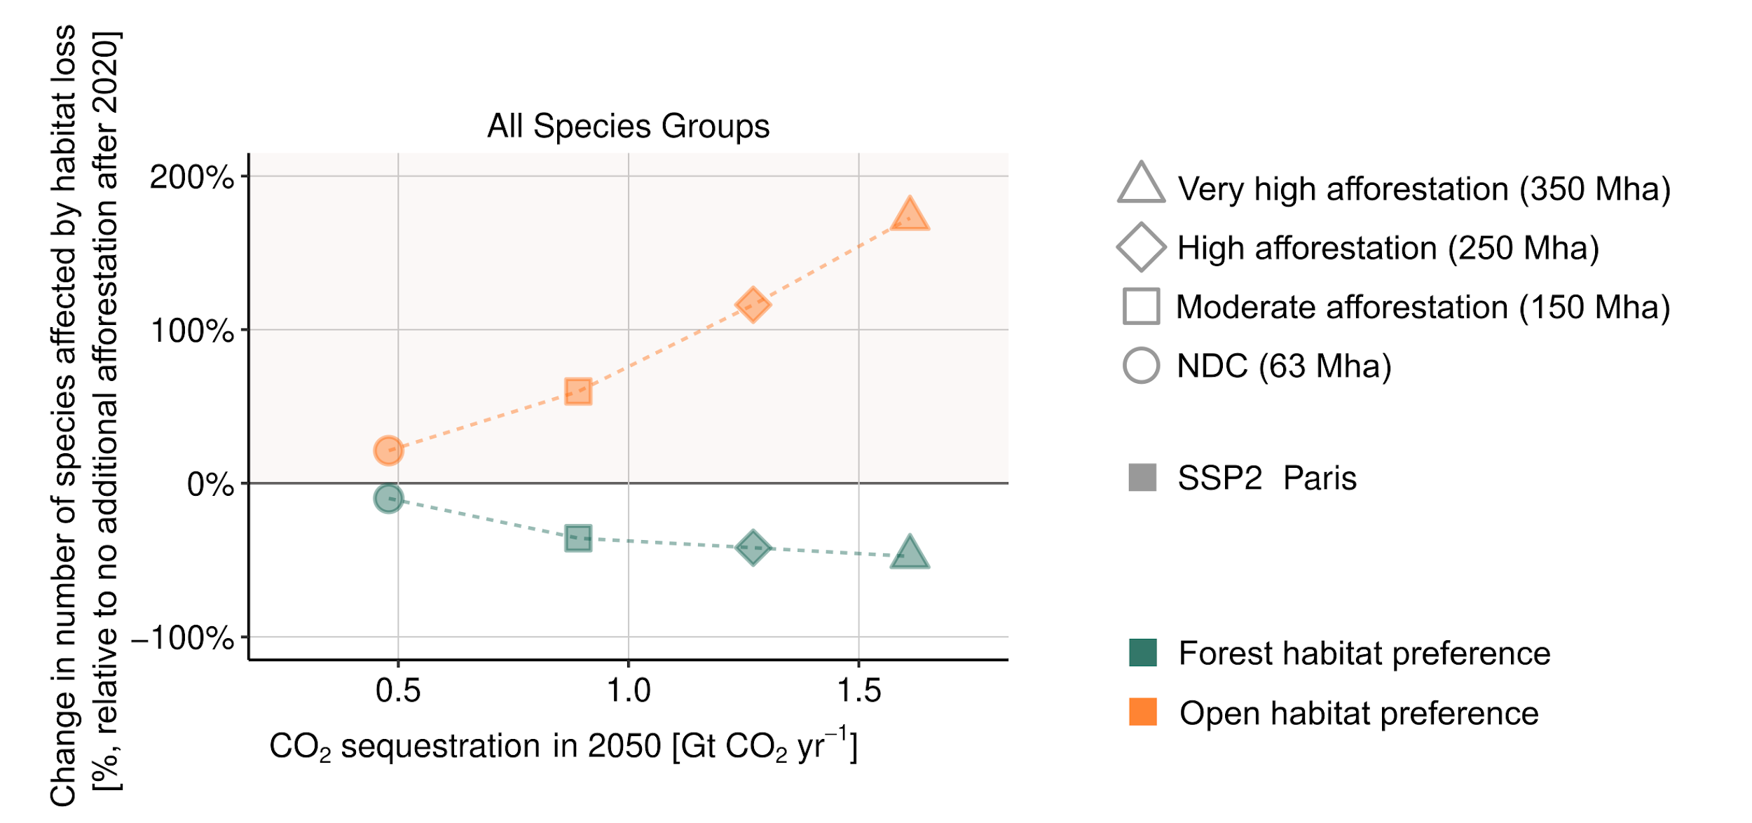

Slide 5
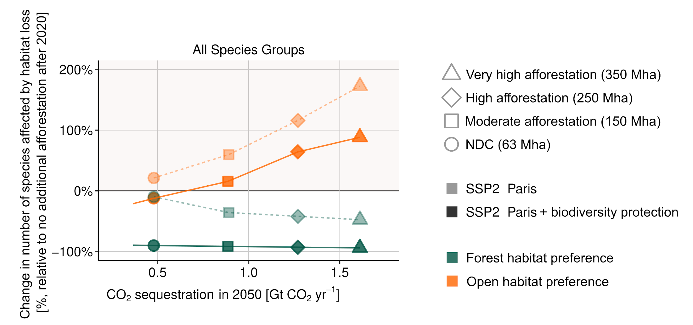

Slide 6
Thanks for listening
Firstname Lastname
Mail-adress

